Slide 1

Course: Data analysis
Irkutsk National Research Technical University
Baikal school of BRICS
09.04.02 Information systems and technology
Program: Information technologies, networks and big data
Atalyan Alina Valerievna
alinaa@mail.ru

Slide 2

Advanced Data Analysis Techniques
Practical class
Cluster Analysis
Multidimensional Scaling

Slide 3
Data Sets
Name: “Arctic_chrysophyte_abundance” (field data, original file data.txt)
Source: Field sampling in Arctic and subarctic regions of Russia (expeditions to Taimyr, Lena River, Kara Sea coast)
Size: 6 observations (sites) of 34 variables (species)
Format: TXT (tab‑separated), header = TRUE, row names = first column
Columns:
lake (character) – Unique site name (e.g., “Ledyanaya Gora”, “Karaul village”, etc.)
Chrysosphaerella brevispina (int) – Abundance score (0–3)
C. coronacircumspina (int) – Abundance score
C. longispina (int) – Abundance score
… (total 34 species columns, each integer 0–3)
*Note: All species columns follow the same coding: 0 = absent, 1 = rare, 2 = moderate, 3 = abundant (semi‑quantitative counts).*
Potential Use for the Practical Class 3 (or similar multivariate analysis):
Computation of distance matrices (Euclidean, Bray–Curtis, Jaccard)
Non‑metric Multidimensional Scaling (NMDS) for ordination
Hierarchical cluster analysis (UPGMA) to group sites by species composition

Slide 4
Cluster Analysis
HIERARCHICAL AGGLOMERATIVE CLUSTER (HAC) ANALYSIS
How HAC Works
Start: Each data point is its own cluster.
Merge: Find the two closest clusters and combine them.
Repeat: Continue merging until all points are in one cluster.
Result: A dendrogram showing cluster hierarchy.
depending on which has smallest
distance in terms of the metric.
Different metrics lead to different kinds of hierarchical agglomerative clustering

Slide 5
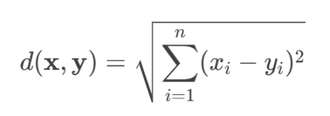
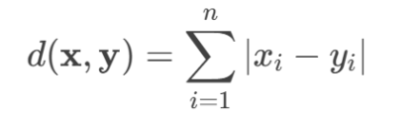
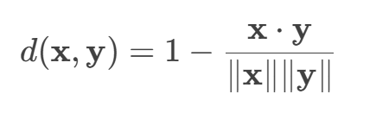
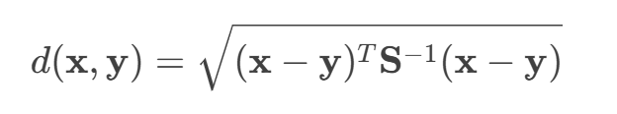
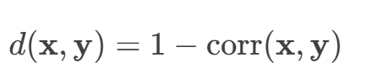
Cluster Analysis
HIERARCHICAL AGGLOMERATIVE CLUSTER (HAC) ANALYSIS
Different metrics
Euclidean Distance
Manhattan Distance
Cosine Similarity
Mahalanobis Distance
Correlation Distance

Slide 6
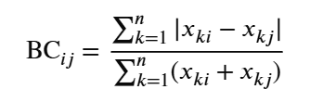
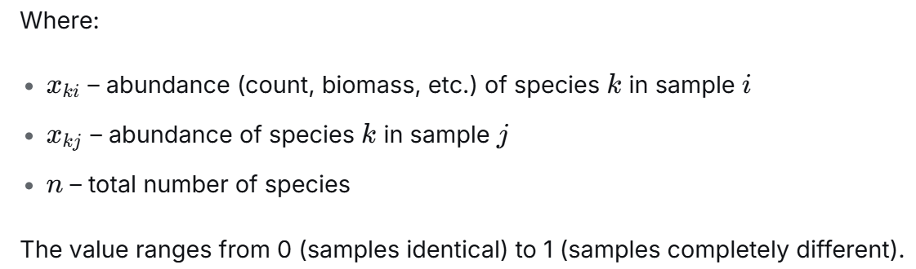
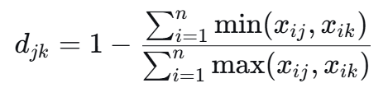
Cluster Analysis
HIERARCHICAL AGGLOMERATIVE CLUSTER (HAC) ANALYSIS
Different metrics
Euclidean Distance
Bray–Curtis Distance
Jaccard distance

Slide 7
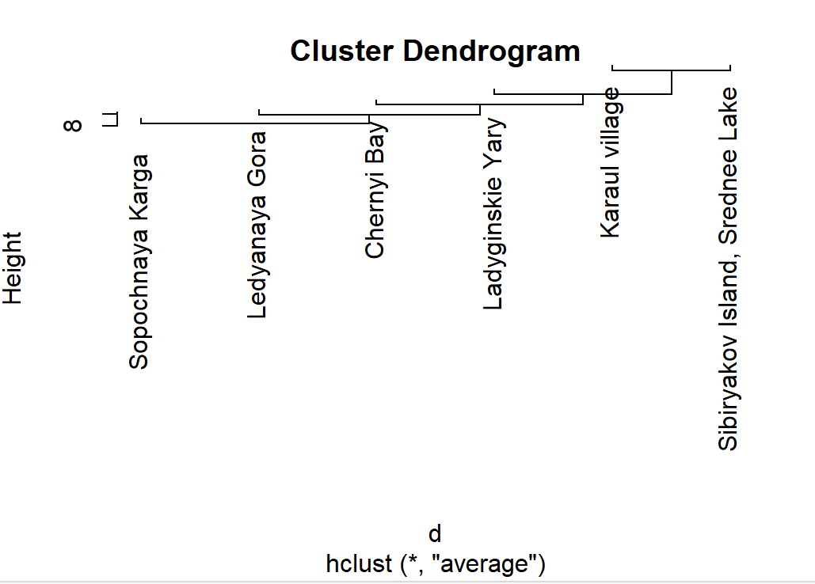
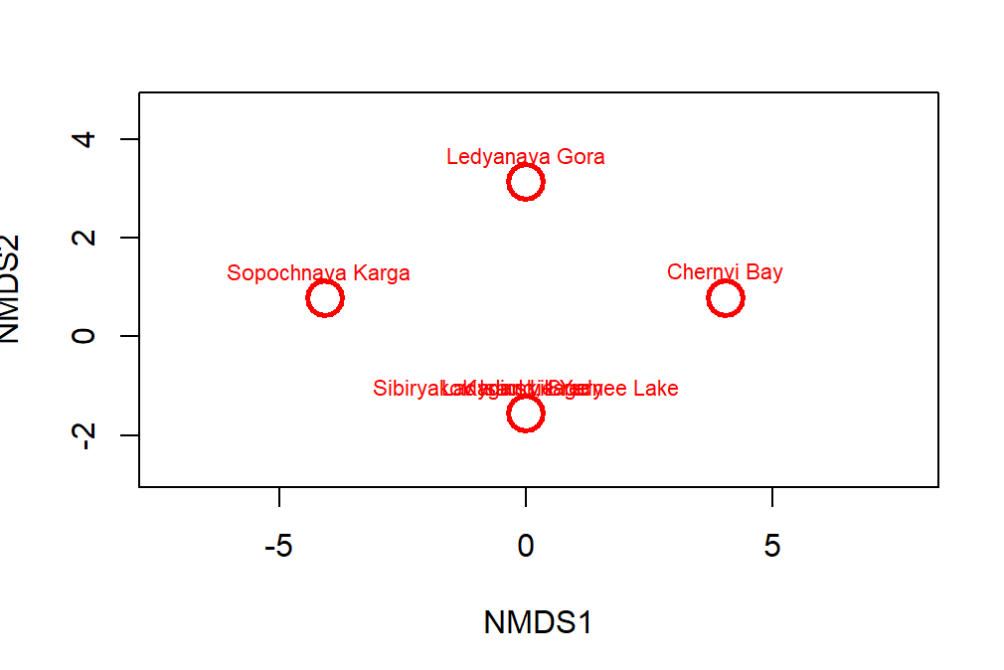
NMDS vs Cluster Analysis
Euclidean distances

Slide 8
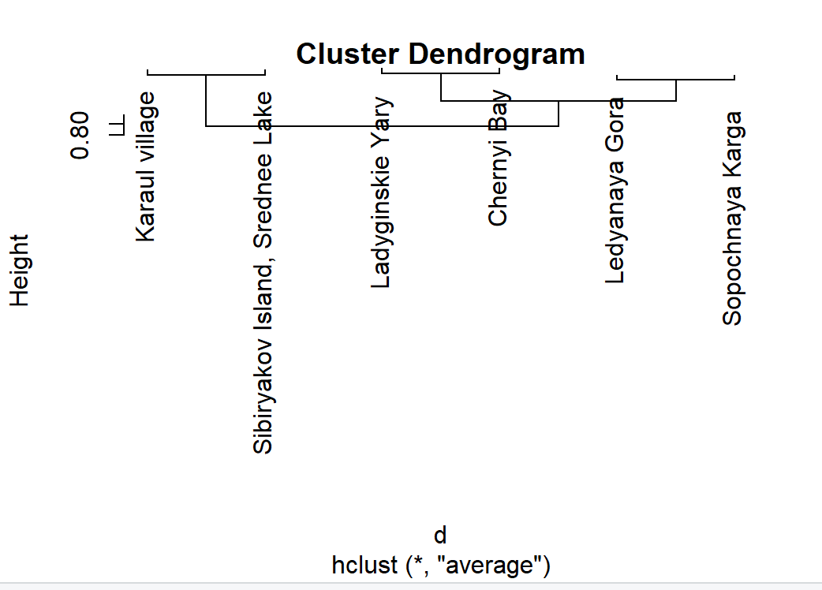
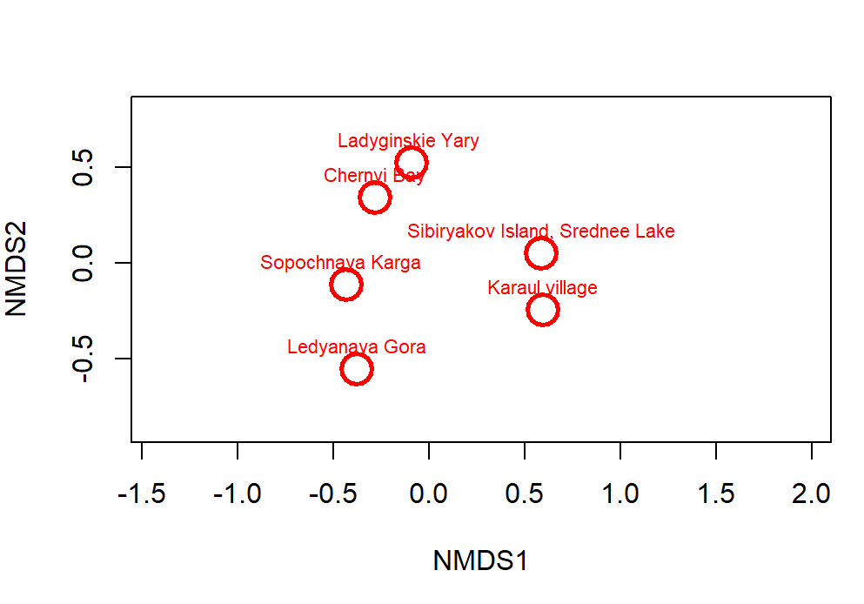
NMDS vs Cluster Analysis
Bray–Curtis distances

Slide 9
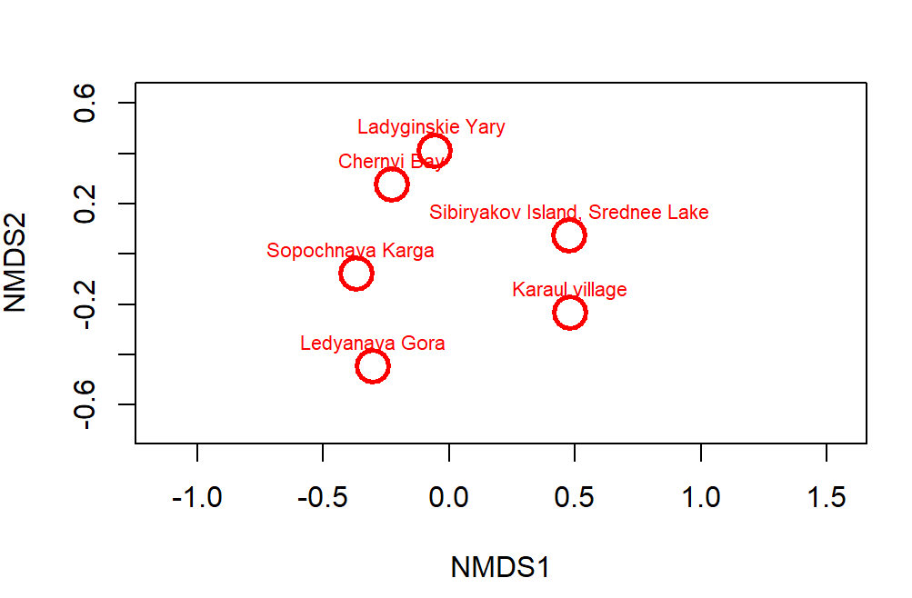
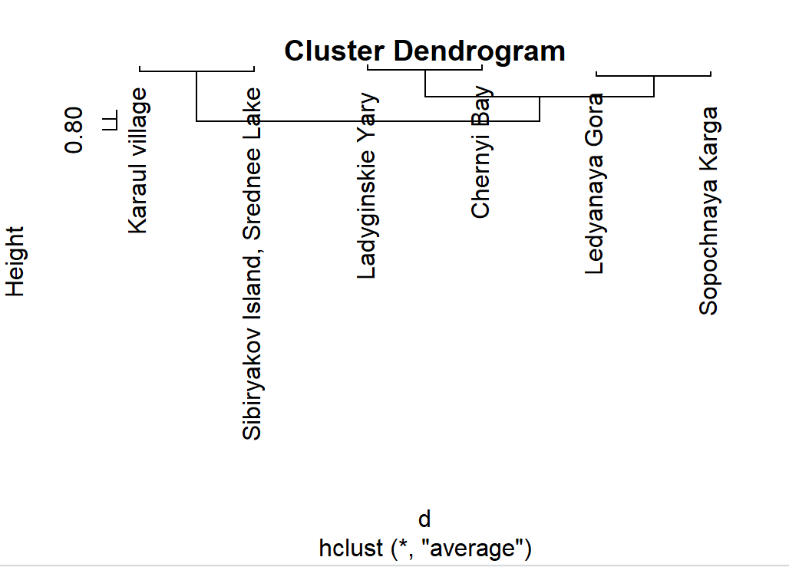
NMDS vs Cluster Analysis
Jaccard distance

Slide 10
NMDS vs Cluster Analysis
Small sample size (n=6) – leads to near‑zero stress for Euclidean NMDS (trivial solution, warning issued).
Distance metric matters – Euclidean is sensitive to double zeros; Bray‑Curtis is ecologically more appropriate for abundance data; Jaccard (quantitative) is similar to Bray‑Curtis.
Clustering unstable – dendrograms differ by metric; no robust grouping can be inferred from only 6 sites.

Slide 11
Task 5
Deadline subgroup 1 19.05.2026 23:59
Deadline subgroup 2 26.05.2026 23:59
Detailed analysis with Bray–Curtis distance
Compute NMDS (metaMDS, distance = "bray").
Fit significant species vectors (envfit, p ≤ 0.05).
Perform UPGMA clustering (hclust with method="average").
Cut dendrogram into 2–3 clusters (cutree).
Plot NMDS with: Points coloured by cluster. Confidence ellipses (ordiellipse).
Significant species arrows (plot(fit_sp, p.max=0.05)). Site labels without overlap (orditorp).
Test differences between clusters
Run PERMANOVA (adonis2, Bray–Curtis, 999 permutations) on the clusters obtained above. Report R² and p‑value. Conclude whether clusters differ significantly in species composition.

